Slide 1








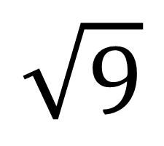
My Angles
Interactive Notebook
Name
Class:
Teacher:
Term 4 Semester 2

Slide 2
Contents
Glossary or Formula Page
Page
Date
Description
2

Slide 3
Tasks
24
7
30
Essential Question
Questions
Notes
Summary
6

Slide 4
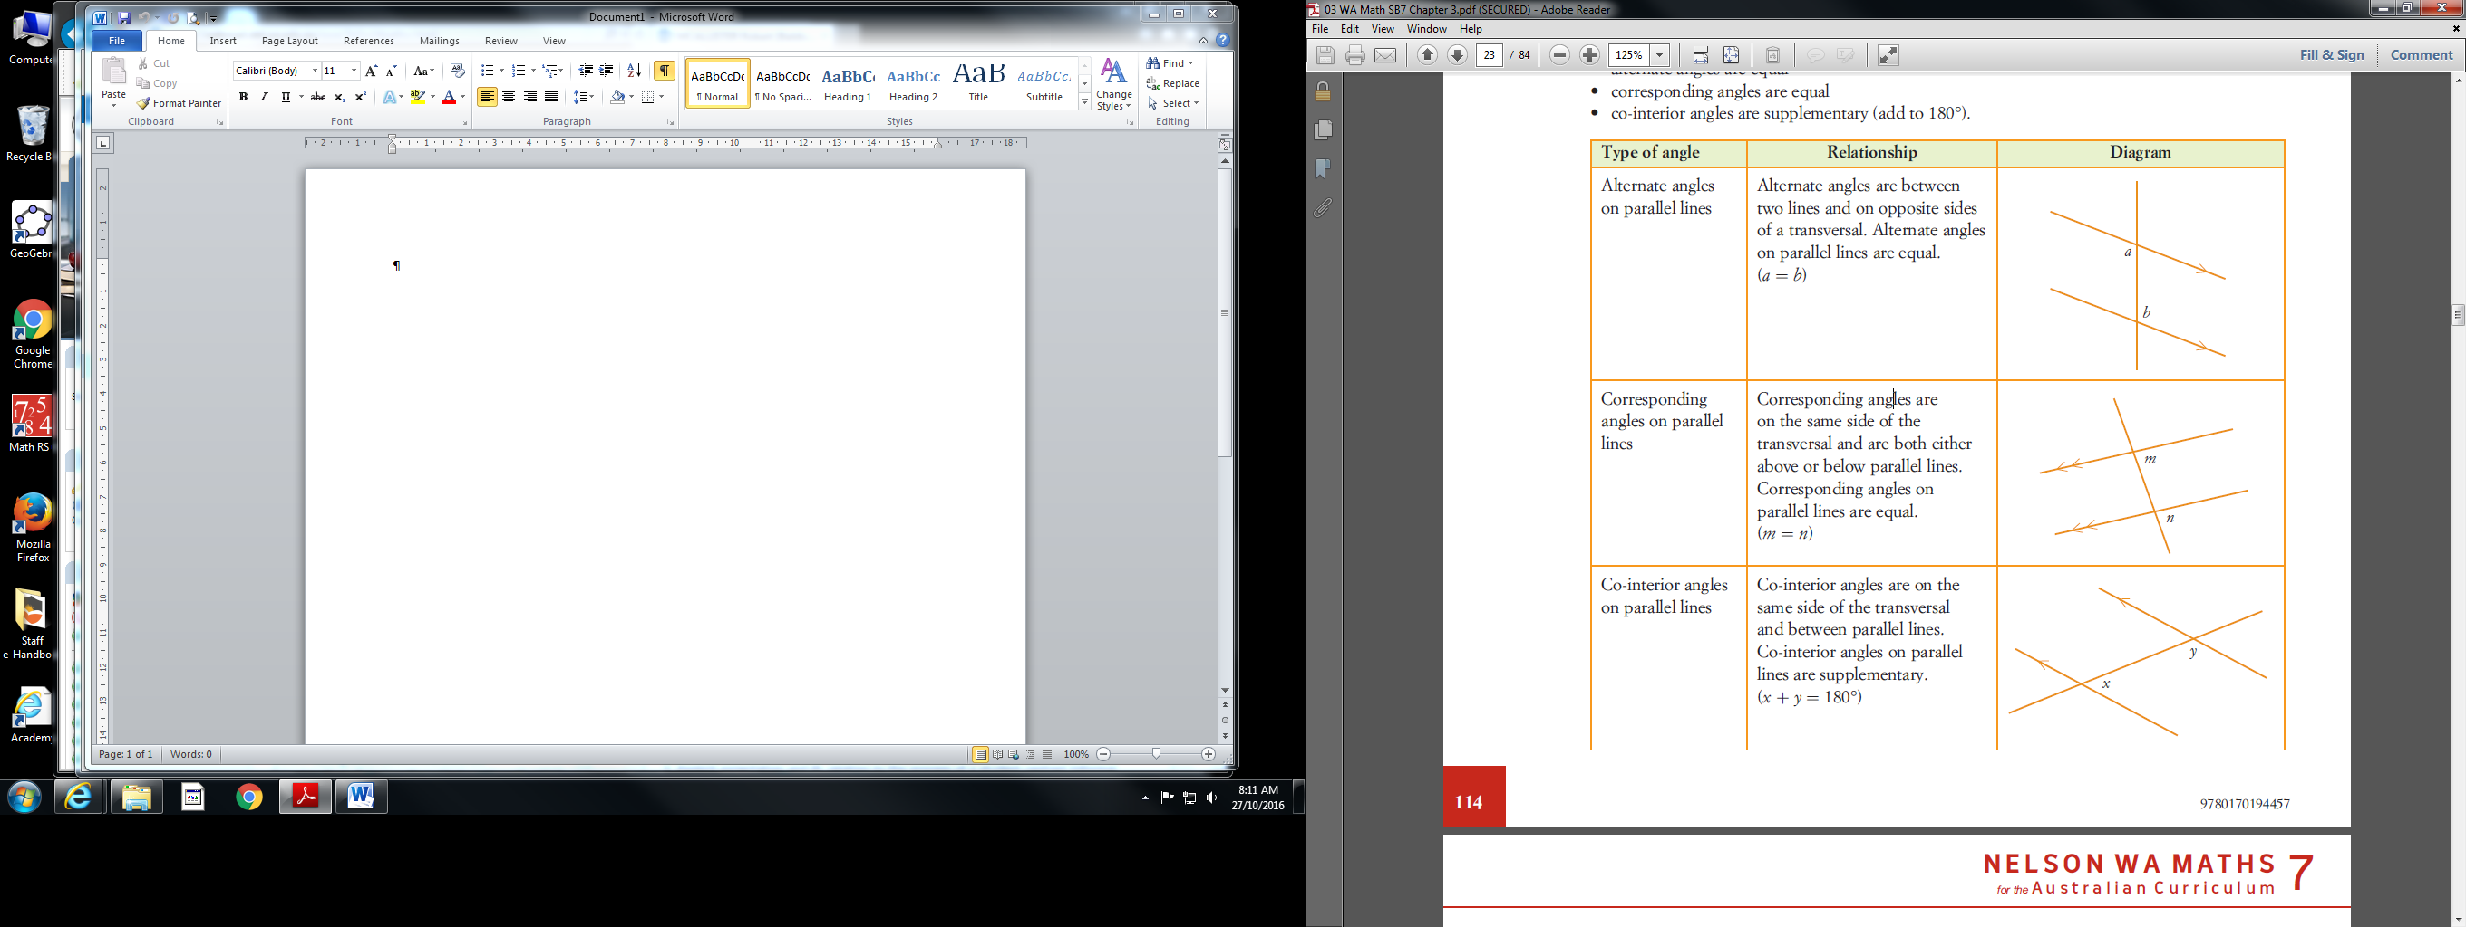
24
7
30
Date
Topic: Parts of an angle and congruent angles
EQ – How do I describe angle relationships?

Slide 5
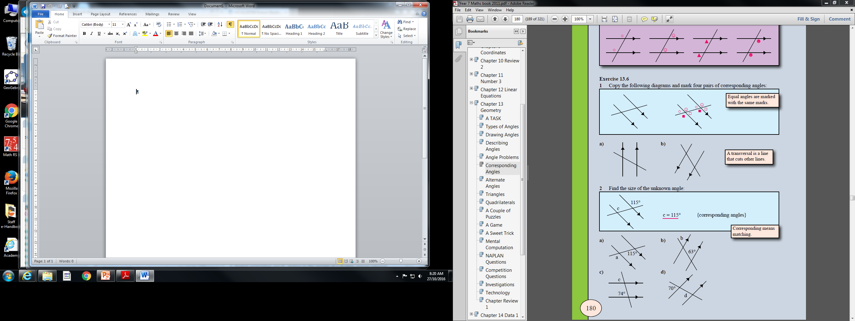

Slide 6
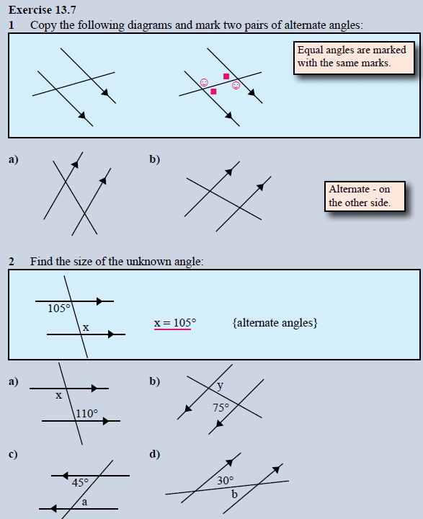

Slide 7
24
7
30
Date
Topic: Parts of an angle and naming angles
EQ – How do I describe an angle?
Exercise 13.6 & 13.7
Page 180 – 181
Worksheet Exercise from Nelson

